Slide 1
Introduction to R and Reproducible Reporting
Patrick Mathias
Lab Medicine Core
Notes:
Greetings everyone.
In this session we are going to cover an introduction to R, Rstudio, and R Markdown.

Slide 2
Lesson Goals
Incorporate best practices for reproducibility and transparency into data analysis projects
Utilize programming and software tools to facilitate efficient, reproducible, and transparent data analytics workflows
Lesson Objectives
Log into the DLMP RStudio server
Create folders and files through RStudio
Create and modify a Quarto document
Notes:
In this first session our goal is to develop some familiarity with the R programming language.
We will also discuss the important role of reproducible data analysis and how R can help us with this.

Slide 3
Why should we care about reproducibility?
Notes:
Without further ado, let’s dive in!!
Getting Started with RStudio.

Slide 4
18
The Duke Cancer Scandal
Chemo sensitivity from microarrays
Errors first, then cover-up
Clinical trials based on flawed models
Papers retracted, lawsuits settled
Notes:
To highlight the importance of reproducibility, let’s consider the following case.
In the mid-2000s, two researchers at Duke University tried to use microarray gene expression data of tumor cells to predict sensitivity to chemotherapeutic agents. This approach generated a lot of excitement at the time, and the resulting work was published in high-profile journals including Nature Medicine, JAMA, and the New England Journal.
(**) Unfortunately, there were a number of serious errors in the data analysis. The media has focused on the fact that the researchers tried to cover up investigations into these errors and press on towards clinical trials even though there were at the time open questions about the validity of the methods.
(**) Even more unfortunately, patients were enrolled in clinical trials and allocated based on flawed models, and in all likelihood patients were actually allocated to incorrect treatment arms.
(**) In the end, 18 papers were retracted, and Duke settled more than 10 lawsuits for an undisclosed amount of money.

Slide 5
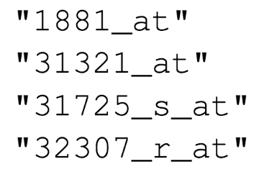
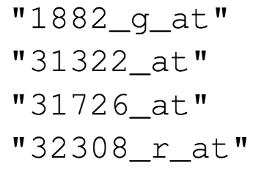

Duke
MD Anderson
Off-by-one indexing error
Notes:
Keith Baggerly and Kevin Coombes, biostatisticians at MD Anderson uncovered the mistakes that led to these retractions, in painstaking work. Let’s look at one of the errors they found.
These are a few of the hundreds of microarray probe sets – each corresponds to a gene – that the Duke investigators reported to predict sensitivity to 5-fluorouracil.
(**) And here are the probe sets that the MD Anderson team got. You can see that those two are different.
(**) If I highlight the last number of each probe, you might notice a pattern: the number of the probe set that Duke reported is exactly one less than the number of the probe that MD Anderson found when they re-did the analysis.
(**) This is what’s called a off-by-one indexing error and is what happens when you use a tool like Excel and accidentally delete one cell. The result is that all the values in the affected column are shifted by one. This is a simple error to make, but as you might imagine, this error invalidates all downstream results.

Slide 6
“Common problems are simple…
Off-by-one indexing error
Sensitive / resistant label reversal
Confounding in experimental design
Inclusion of data from non-reported sources
Wrong figure shown
… and simple problems are common.”
Highly recommended Keith Baggerly lecture: https://bit.ly/duke_scandal
Notes:
The off-by-one indexing error was just one of many simple errors the MD Anderson team discovered.
(**) Another type of error that was pervasive in the study was label reversal so that cell lines were labeled sensitive to a drug when they actually were resistant, and vice versa. That type of error can lead to a scenario where a patient gets the chemotherapy that would be predicted to be least beneficial.
(**) Other problems they identified were confounding, (**) inclusion of data from sources that were not reported in the paper, (**) and wrong figure shown.
These are all simple errors – you don’t have to be incompetent or negligent to make them. (**) Because these errors are so easy to make and because without good documentation or a reproducible workflow it’s hard to catch them, they are also very common.

Slide 7
Point-and-click is not inherently reproducible
Computer code can precisely document each step of the analysis
Notes:
A key issue in this case study is that the investigators used “point and click” tools like Excel.
This prevented peers and independent investigators from catching errors in the analysis, until it was too late.
And the Duke case study is only one example where the critical barrier to reproducibility was the tendency of investigators to use graphical user interface “point-and-click” type tools. These interactive tools usually don’t record user actions and because of this, they are fundamentally not reproducible.

Slide 8
Reproducibility can be achieved when the following criteria are met
All methods are fully reported
All data and files used for the analysis are available
The process of analyzing raw data is well reported and preserved
Same data + Same script = Same results
https://www.r-bloggers.com/2016/06/what-is-reproducible-research/

Slide 9
Why YOU should analyze your data reproducibly
“Can we redo the analysis with this month’s data?”
“Why do the data in Table 1 not seem to agree with Figure 2?”
“Why did I decide to omit these six samples from my analysis?”
Your closest collaborator is You from 6 months ago
Notes:
But reproducibility doesn’t only help others. Consider the following 3 statements and ask yourself if they sound familiar.
-Can we redo the analysis with this month’s data?
-Why do the data in Table 1 not seem to agree with Figure 2?
-Why did I decide to omit these six samples from my analysis?
**Your closest collaborator is you from 6 months ago. You can do yourself a huge favor by using tools that promote reproducibility.
And if you are analyzing clinical data and might affect patient management or public health based on your findings, that makes it so much more important that you take steps to assure your analysis is documented, free of errors, and reproducible by others.

Slide 10
R Course Introduction
Notes:
I'm here just to give you a quick introduction after which we'll dive right into the meat of the workshop.

Slide 11
Course Goals and Objectives
Establish good practices for working with data safely
Teach features of the R programming language that improve reproducibility in clinical data analysis
Demonstrate how R can be used to perform analyses of laboratory operational data
Establish a basis of understanding in the 'tidy' approach to data analysis
Notes:
Obviously we would love for those who are here today to all walk away and just start coding but the reality is that while that would be great we also have a set of more modest if more important goals
We're here to Advocate for the use of R as a means of improving reproducibility in clinical data analysis and I cannot emphasize enough how strongly we feel about this point
As we review this we will demonstrate how we can use R perform analyses of laboratory operational data
And we also hope to establish a baseline understanding of what tidy data is and how to implement a 'tidy' approach to data analysis within the framework of R

Slide 12
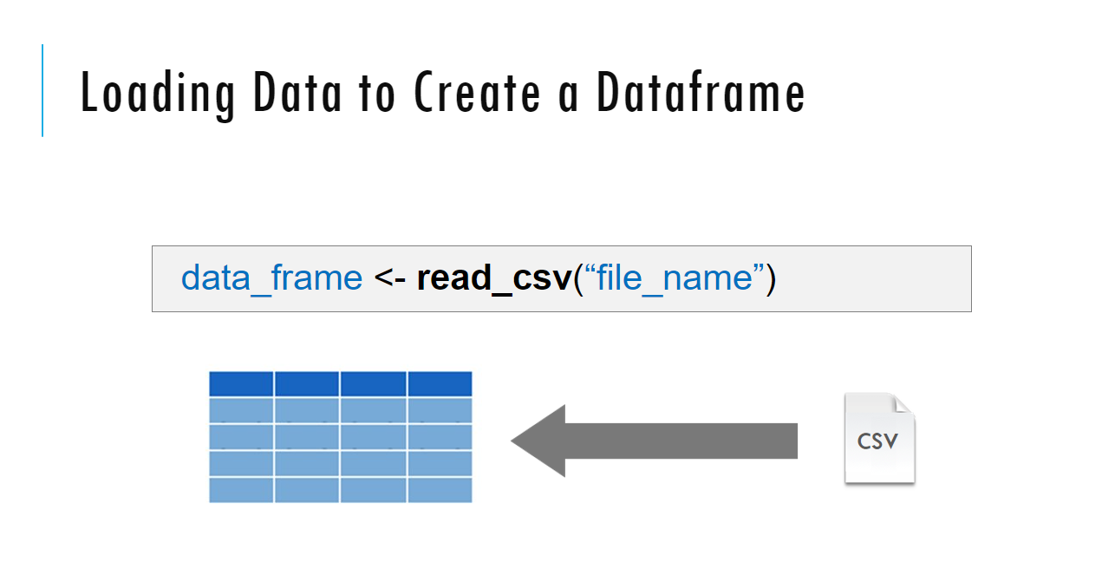
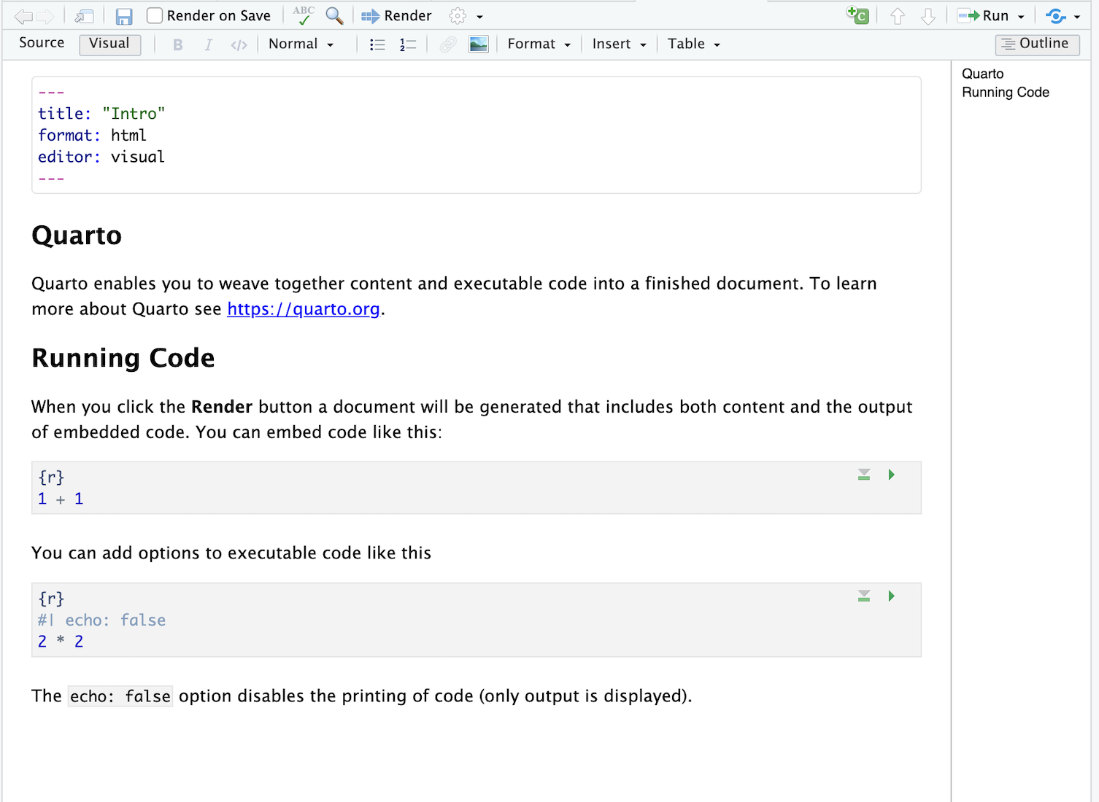
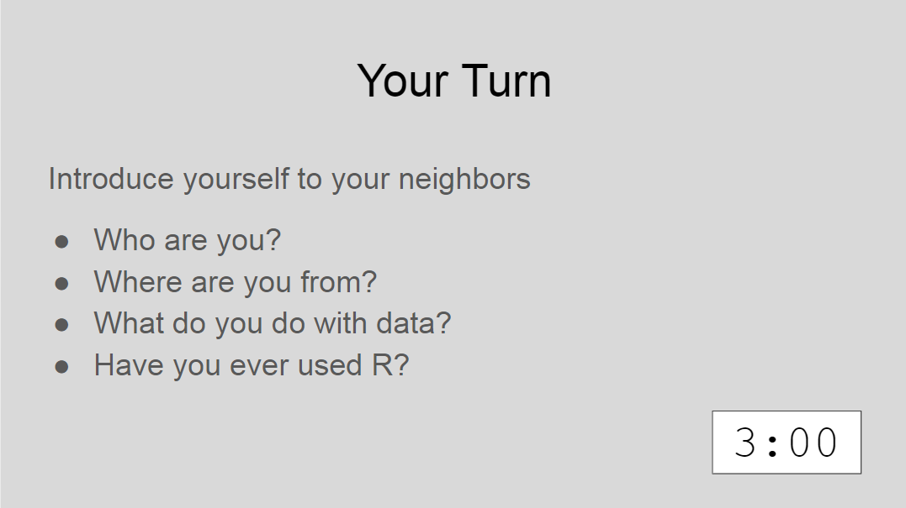
Sessions
Notes:
The meat of the workshop are the sessions each of which will cover discrete subjects or components of R in a data analysis. The sessions have a powerpoint associated with it as well as an R script.
We'll be describing a specific function or topic in the context of the powerpoint – all of which are included in the coursebook and available for download. The same code that is being demoed is included in the R script and you are invited to follow along, run the code, play with it if you like.
At several points in the session we'll have you engage in some exercises which we call Your Turns. In a Your Turn we'll assess how we're doing by asking you to critically think about the topic in the session and respond to a question or do some coding on your own. We'll speak a bit later about how these coding exercises will work.

Slide 13
Tips for learning
Cheatsheets show how to do common things – orient yourself with them early
The best way to learn to code is by doing
Practice is key!
Programming is hard, even for those with a lot of experience. Find resources and ask for help!
Notes:
And just some final words before we begin, no matter what you're learning but particularly coding, the best way to learn is by doing:
Find a project, make a goal for yourself, push yourself to use R, it's OK to lean on some excel, we all do when we're starting out, but try to get that activation energy to get your hands typing code. We would not be teaching this course if we didn't strongly believe that R is accessible to all of you. So keep practicing and you'll get there.
With that let's get started with the workshop. Up next Joe will provide us with the basics of R and get us up and running with Rstudio Cloud.

Slide 14

Onward!
We will sign onto our DLMP server to use Rstudio for these lessons: https://rstudio.dlmp.uw.edu/
This resource will be available for you while you are at UW
It is secure for protected health information (but be careful about where you transfer PHI to get it to the RStudio server)
Course material available at: https://github.com/pcmathias/dlmp-data-analysis-with-r
Please fill out pre-course survey: https://bit.ly/4ei10u0

Slide 15
Getting started with RStudio and Quarto
Notes:
Without further ado, let’s dive in!!
Getting Started with RStudio.

Slide 16




R
Programming language for
data analysis
RStudio
Interactive development environment (IDE)
R Markdown
Computational document format
Quarto
Computational document format
Notes:
I’m sure you all are excited to get started programming and we will do that in just a few minutes.
Before we do that I want to introduce you to 3 items.
The first is R. R is a programming language for data analysis. There are lots of great things about R: it is freely available, great for wrangling data, and very capable for producing impressive visualizations. There is also a great community of folks using it for data science, and we are excited to welcome you all to the R community via this course.
(**) Then, there’s RStudio. RStudio is the name of a free piece of software made by the company Posit (formerly known as RStudio). You can think of RStudio as a sophisticated text editor for writing R code. You can run RStudio on Mac or Windows, or on a server.
(**) Finally there’s R Markdown. (**) Or at least that what we used to say when we taught this course. The next generation of R Markdown known as (**) Quarto was recently released. Quarto is a computational document format that has executable code. Quarto also includes capabilities for annotating your work which is incredibly handy and supports multiple programming languages for mixing and matching code.
R, RStudio, and Quarto synergize for a robust ecosystem for performing data analysis.

Slide 17

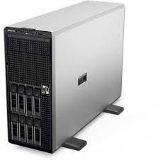
RStudio: Hosted Remotely and In Your Home
RStudio Desktop
Installed locally on your computer
RStudio Server
Hosted on a server (DLMP Server)
Ensure that local computing resources (e.g. your personal computer) are encrypted and secure before working with PHI. It’s safest to use DLMP resources to do your work.
Notes:
As I just mentioned RStudio can be installed on a server or locally on your computer.
RStudio Server – a version of the RStudio IDE that can be accessed from a web browser. This is what we will use as a training environment today.
RStudio Desktop – a version of the RStudio IDE that is installed on your computer. This is what you should use after the course to continue learning R and working on R projects.
On the course website (https://github.com/pcmathias/AACC-2021-Introduction-to-R), we included links to videos demonstrating how to complete a local install of RStudio Desktop. We also provide access to the course content via a github repository. So though the training environment is ephemeral, you will have access to the course content in the future.
One last reminder, please don’t upload any external data (and especially PHI) to the cloud!

Slide 18
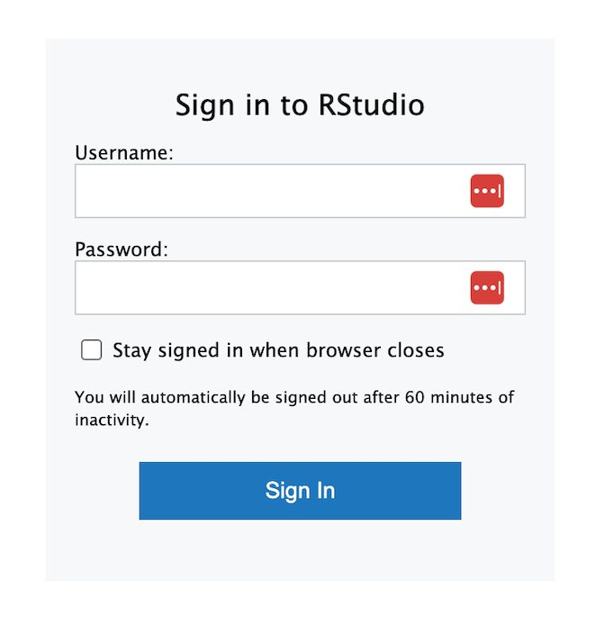
Your Turn #1
Navigate to: https://rstudio.dlmp.uw.edu/
First enter your NetID credentials
Enter your AMC (Epic) credentials at the “Sign in to RStudio” screen
Post your sticky when you are done
Notes:
Let’s take a few minutes to get logged into RStudio Cloud.
In the pre-course email, we asked you to create an RStudio log in. Use those credentials now to access the cloud instance.
The following slides show the clicks to copy the workspace.

Slide 19
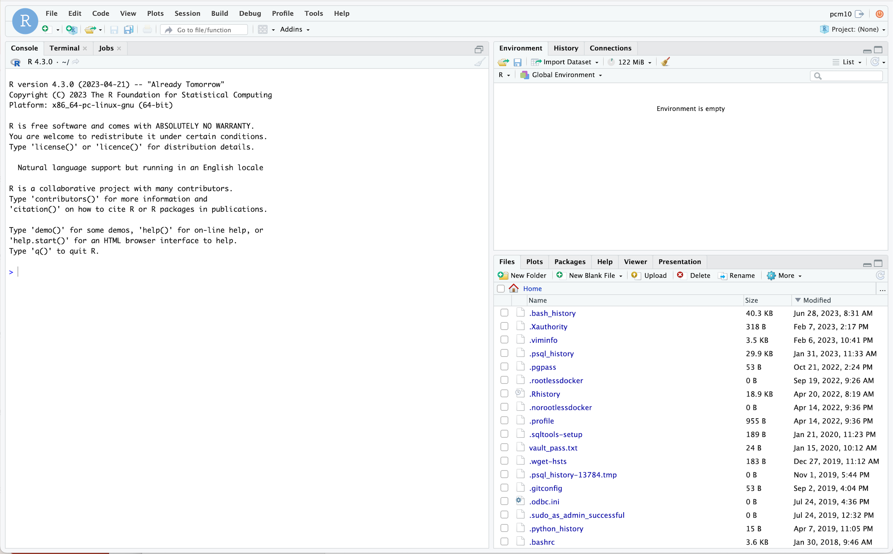
ENVIRONMENT
CONSOLE
FILES
Notes:
Wait for for your version of the project to spin up.
Your screen will look like this when the work space is finished loading.

Slide 20
Setting Up a Project on the DLMP Server
Notes:
One of the most powerful aspects of working in the R environment is the ability to conduct reproducible data analyses (those analyses that can be shared, revised, repurposed and reproduced) by others.

Slide 21
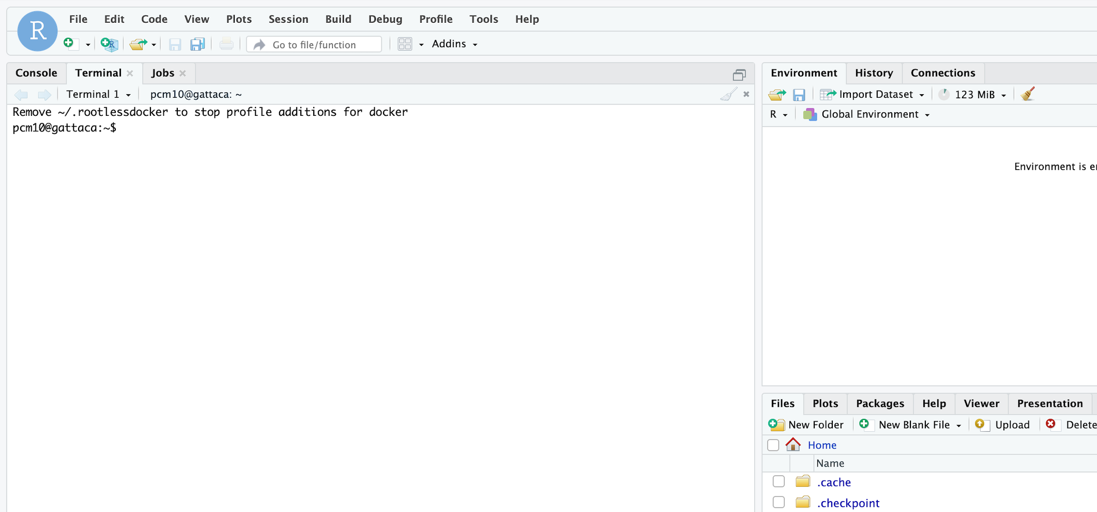
Working with our DLMP RStudio server gattaca
Linux server (open source operating system)
Every user has a private file structure under their username
There are some public folders above the individual user level
Terminal tab takes you to “command line” for operating system

Slide 22
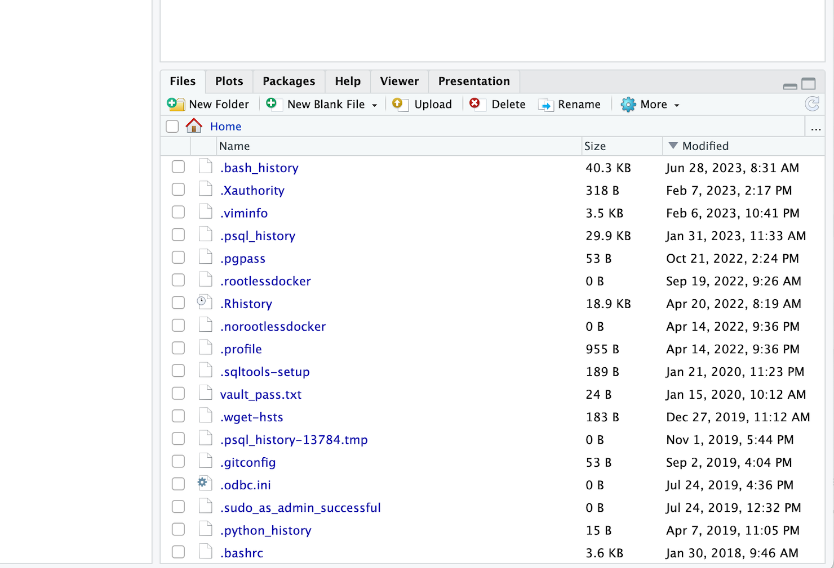

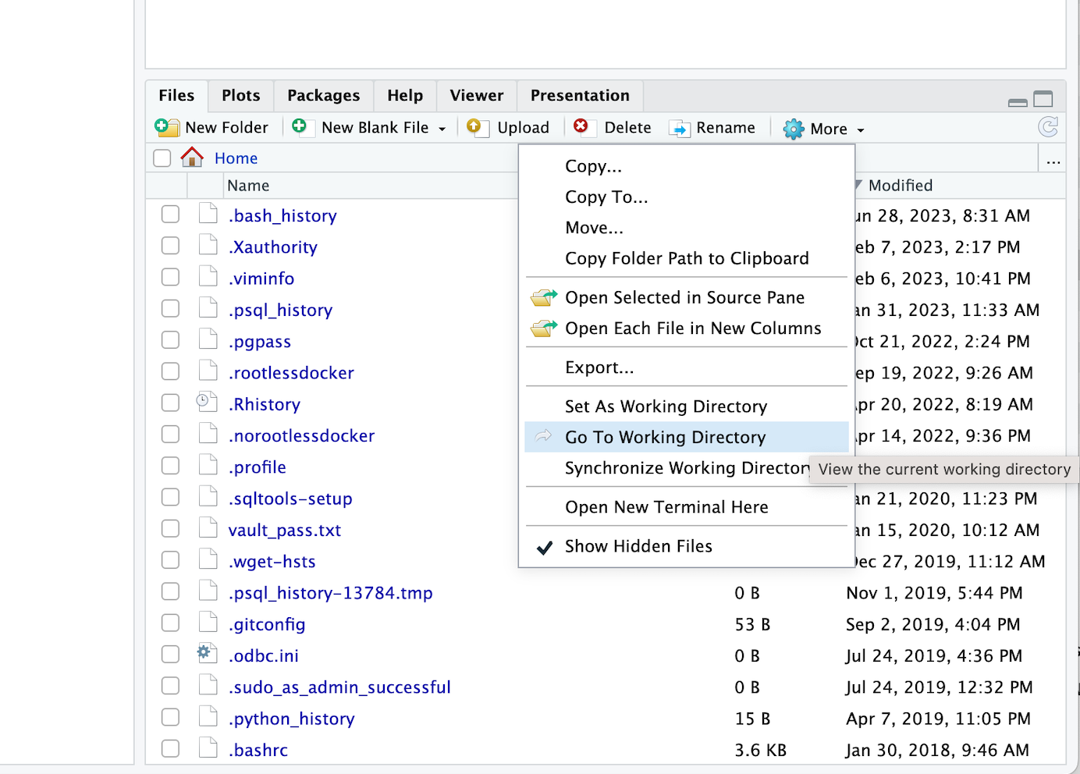
Orienting yourself in the file structure using RStudio
mnt
home
username (NetID)
Home Directory
Files and folders that start with a “.” are hidden
Your Folders

Slide 23
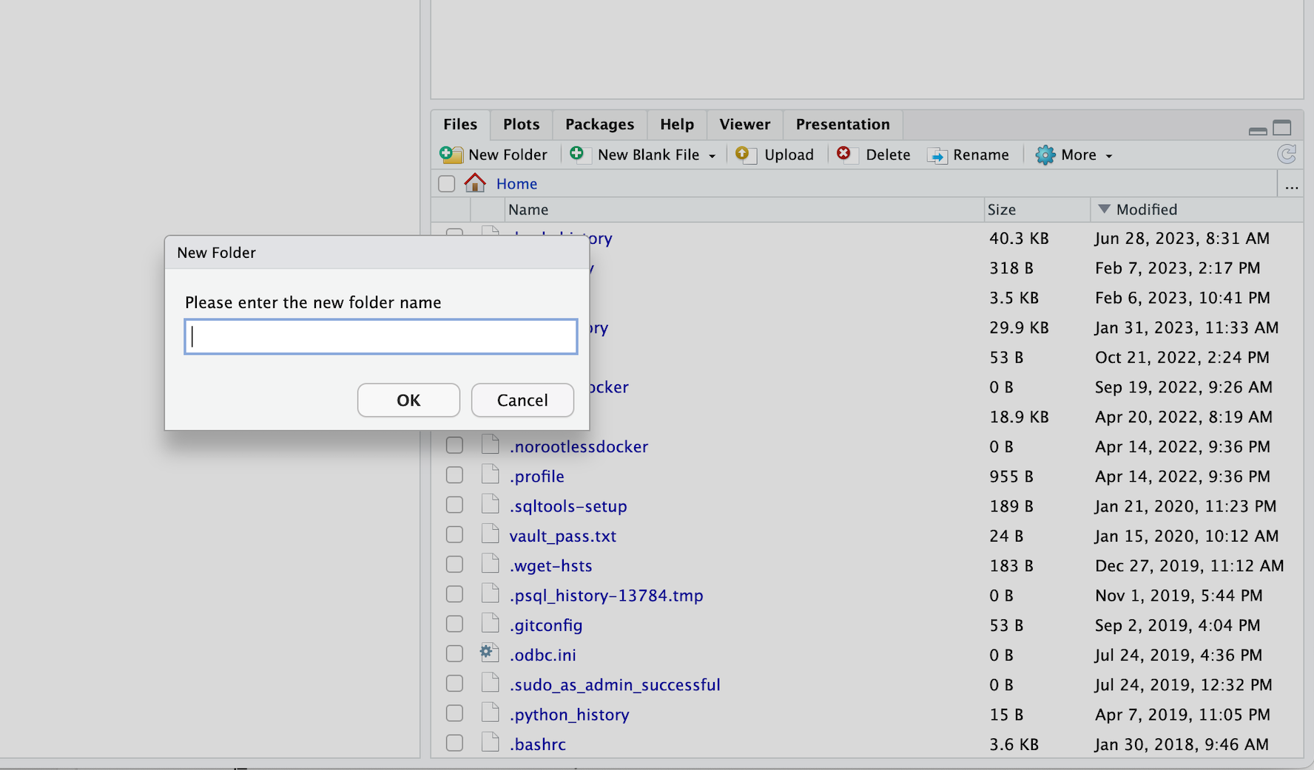
Create a new folder
New folder will appear in the current directory you see in Files tab

Slide 24
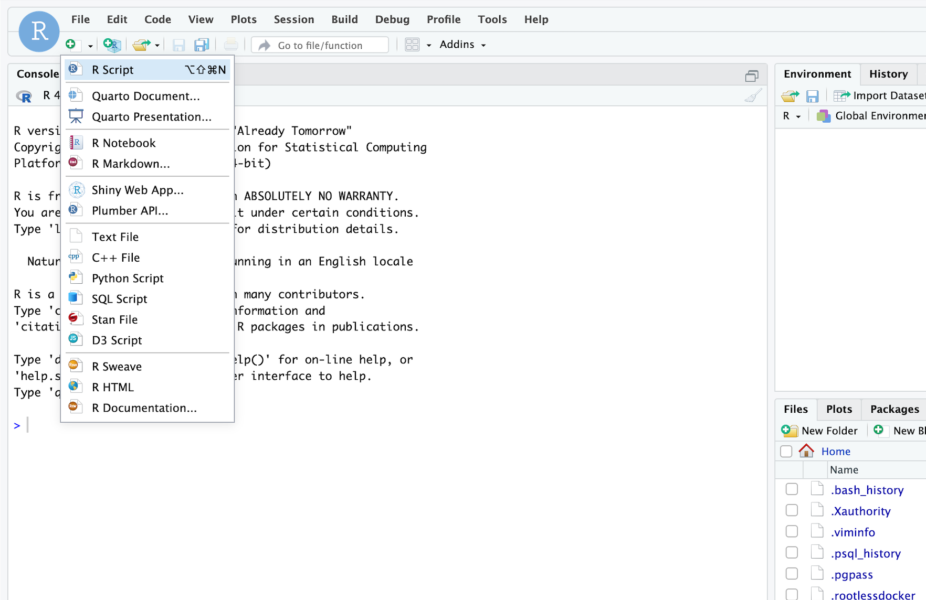
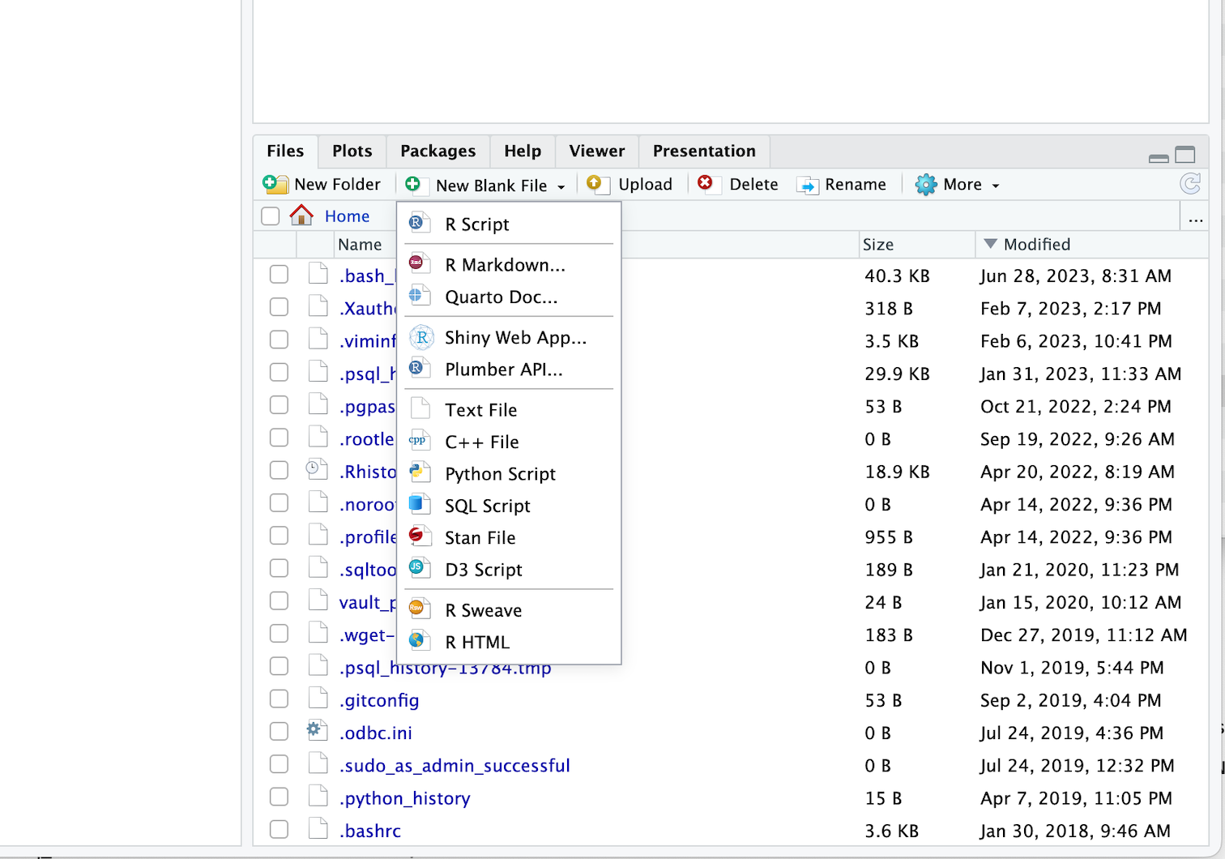
Create a new file
At File window
Above Console

Slide 25
Your Turn #2
Within your RStudio window, navigate to your working directory using Go To Working Directory (Are you at your username directory on the system? If not, navigate there and select Set As Working Directory)
Create a new folder named projects (capitalization is your choice)
Navigate there and create another folder called core
Go to your core folder and select Set As Working Directory from the More menu in the Files tab
Post your sticky when done

Slide 26
Best Practice: Build a project folder structure to organize your work
You will find it much easier to recycle previous work if you have a clear structure for organizing your projects
Make a folder for each project
Include folders within the project folder for at least the following:
Data (raw data)
Output (figures and/or intermediate tables or files) – can choose to put intermediate files into a separate folder
Analysis files – can choose to keep this in main folder

Slide 27
Reproducible Data Analysis with Quarto
Notes:
One of the most powerful aspects of working in the R environment is the ability to conduct reproducible data analyses (those analyses that can be shared, revised, repurposed and reproduced) by others.

Slide 28
Notes:
Quarto provides us with features and tools to tackle the reproducibility problem.
In Quarto, we can craft computer code mixed in with narrative annotation that documents the purpose of the code and details about the decisions we made in our analysis.
Quarto provides a lab notebook interface for analysis, visualization, and annotation of our work.
Like R Markdown before it, Quarto is quickly becoming the gold standard for reproducible data analysis. In the course we will teach you to use Quarto and we encourage you to continue using it consistently in your future work. In fact, it is the strongest recommendation we will make to you today.

Slide 29
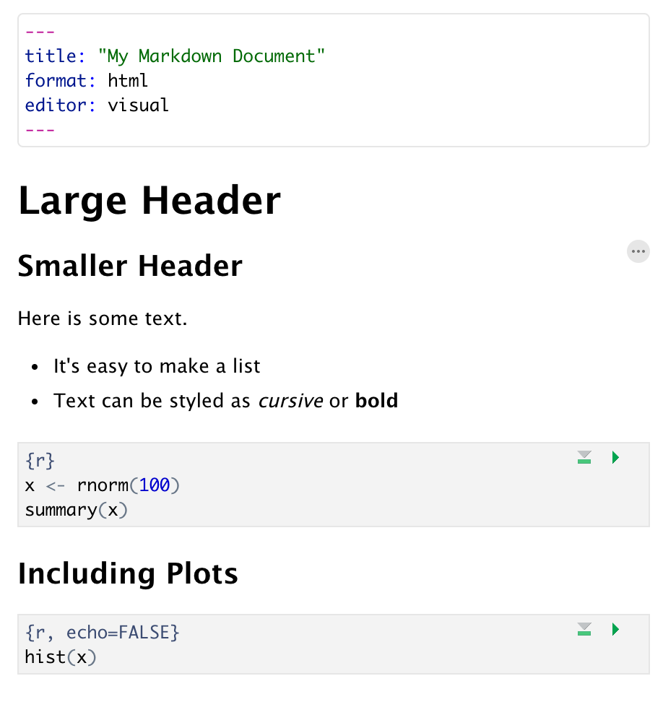
Anatomy of a Quarto Document
Header
Header
Text (w/ formatting)
Code chunk
Notes:
Quarto documents are composed of 3 basic building blocks.
**The first is the Header which includes pieces like the name of the document, the document’s author, and the desired output format when the document is assembled.
**The second block is the text. Quarto documents can be marked in ways that promote readability with various formatting styles.
**Finally, there are code chunks. Code chunks include include R code that can be executed to output results.

Slide 30
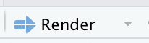
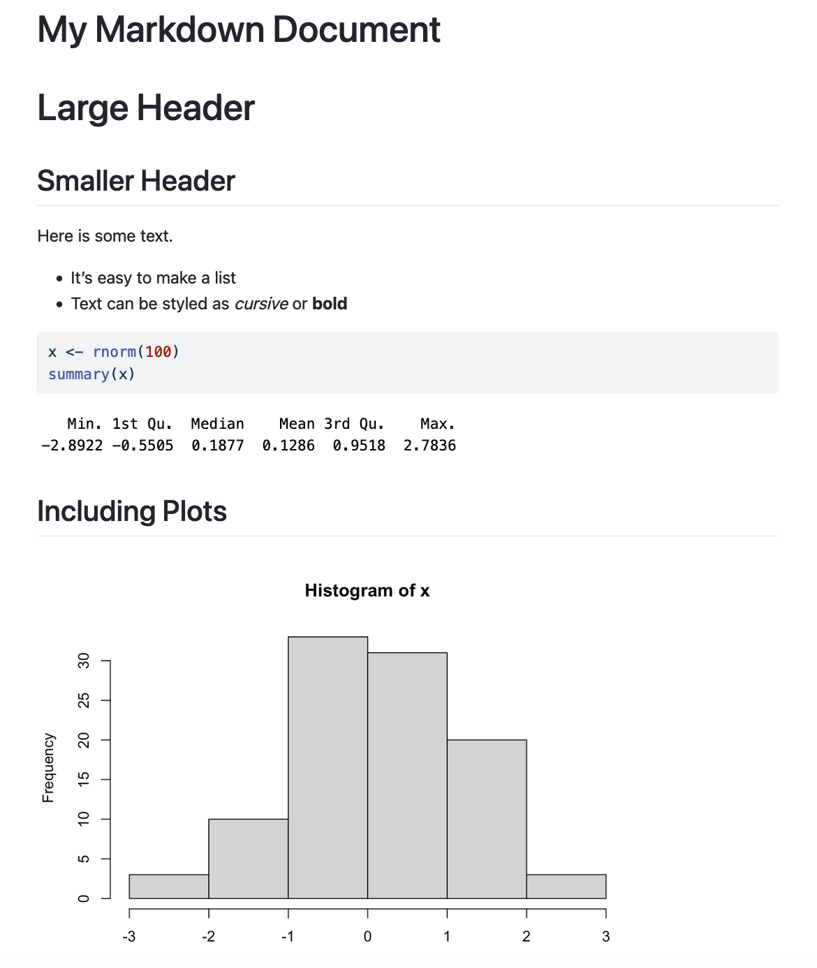
Notes:
Within the Quarto document, we can execute a single code chunk by ** clicking the “Run Code Chunk” arrow.
And with the click of a button ** (called rendering), we can turn a Quarto document from this (**) to this.

Slide 31
Notes:
Let’s look at this Quarto document in greater detail.
Again the first block is header section
** The second block includes narrative text with styling applied.
** Then we get to the code chunks (shown in gray boxes). Don’t worry about the grammar of these particular code chunks at this point. In brief the first code chunk generates 100 normally distributed values which are performing a summary on. The rendered document shows us our code ** and the output of that code.
** The second code chunk renders a histogram visualization of that data.
The result is a neatly formatted document that includes an annotated description of our analysis, the code we used, and the output of that code.

Slide 32
Your Turn #2
Open a sample Quarto document (File -> New File -> Quarto Document). Enter My First Quarto as the title in the prompt and press Create.
Review the format of the document: header, text, code chunks
Execute the individual code chunks by selecting the Run Current Chunk arrow.
Render the document to HTML. You will prompted to save your Quarto Document first. Name it 01 – Quarto Intro and click save. Review the rendered document.
Notes:
It’s your turn again.
Follow the instructions in Your Turn #2 to
-open a Quarto document
-review the format
-execute individual code chunks
-render the document
We will meet back in 3 minutes to review this exercise together.

Slide 33
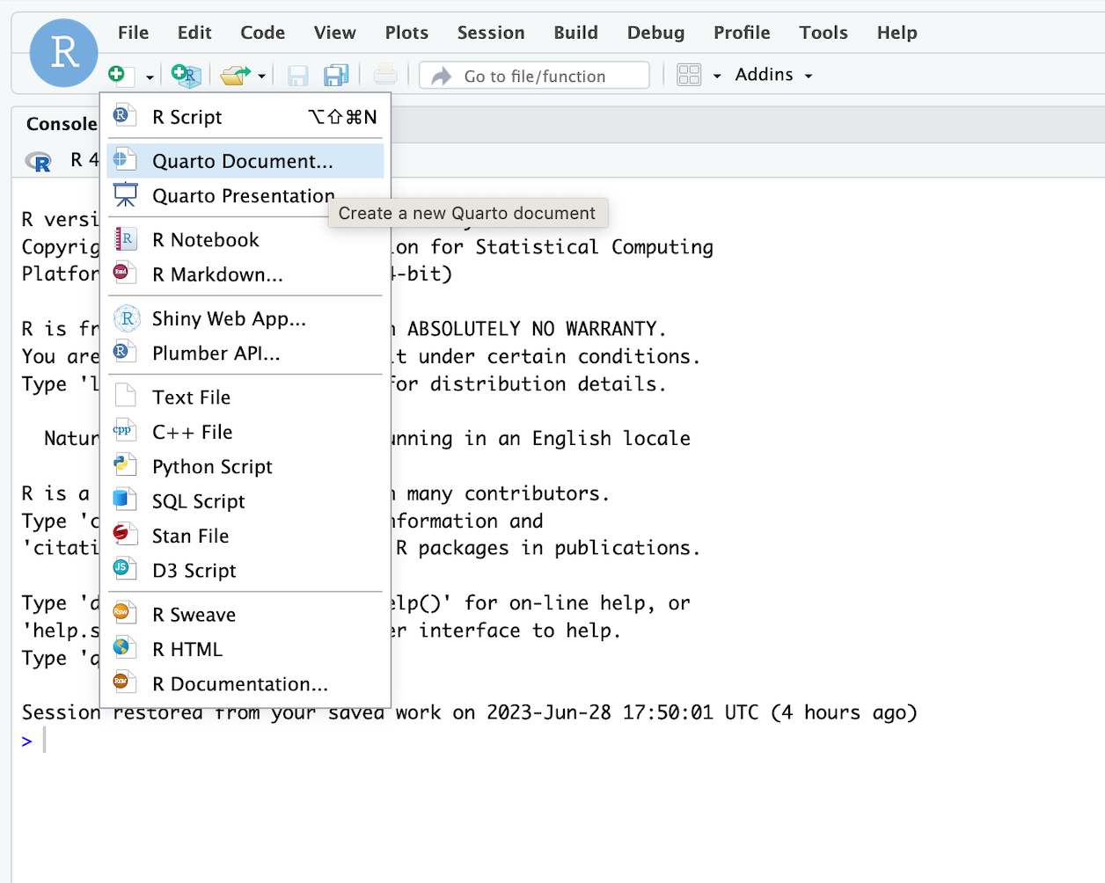

Slide 34
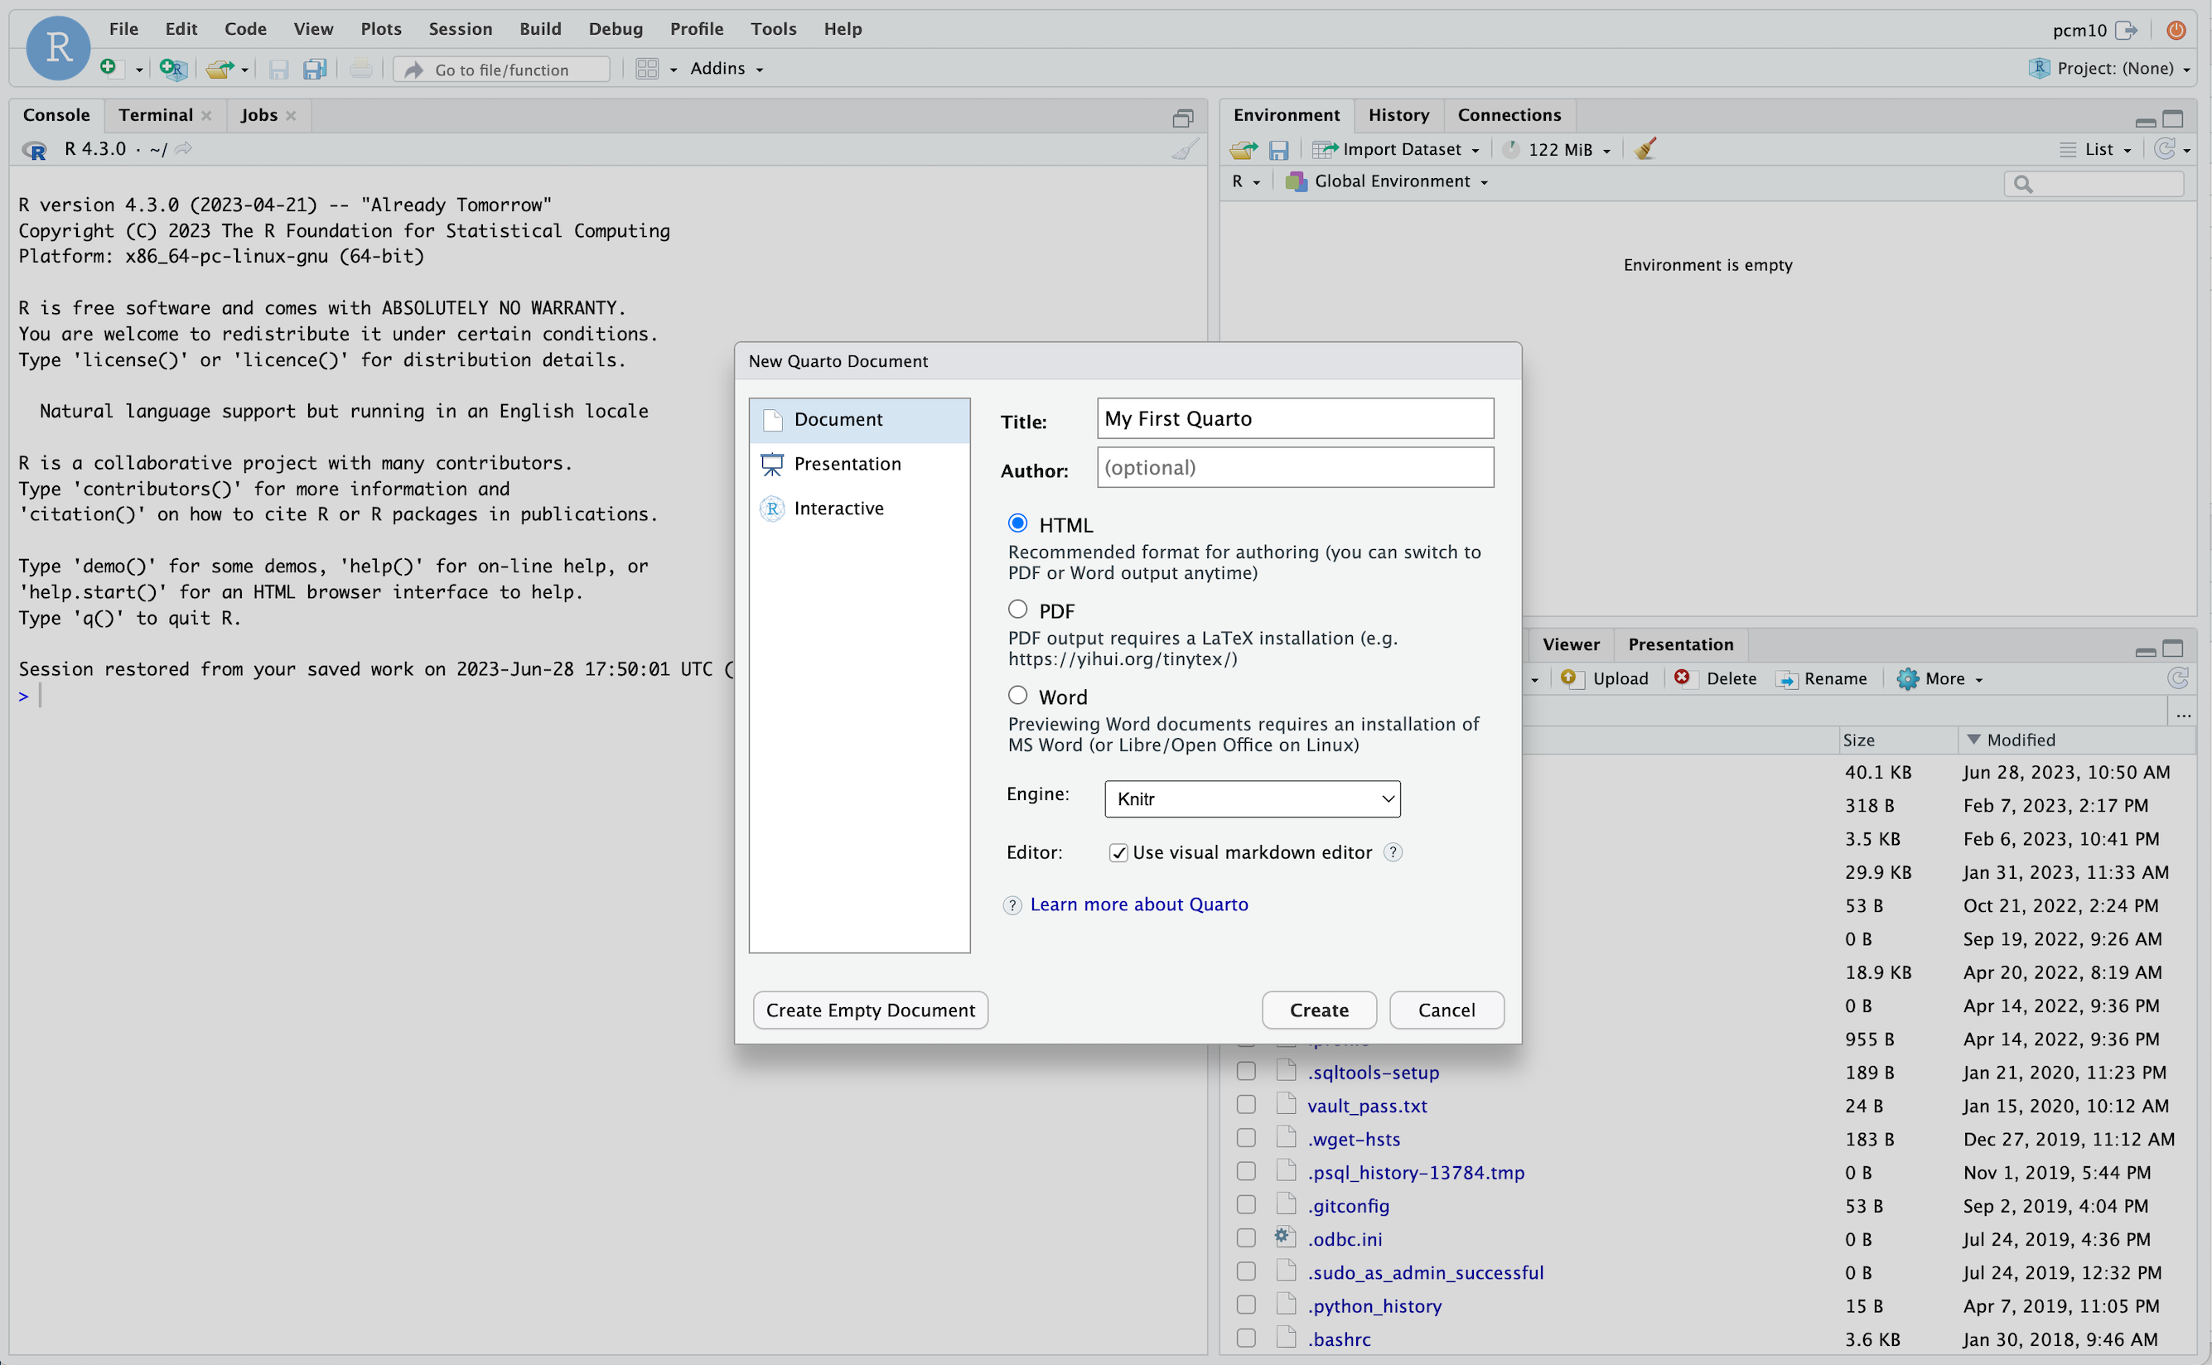
Enter title
Create document

Slide 35
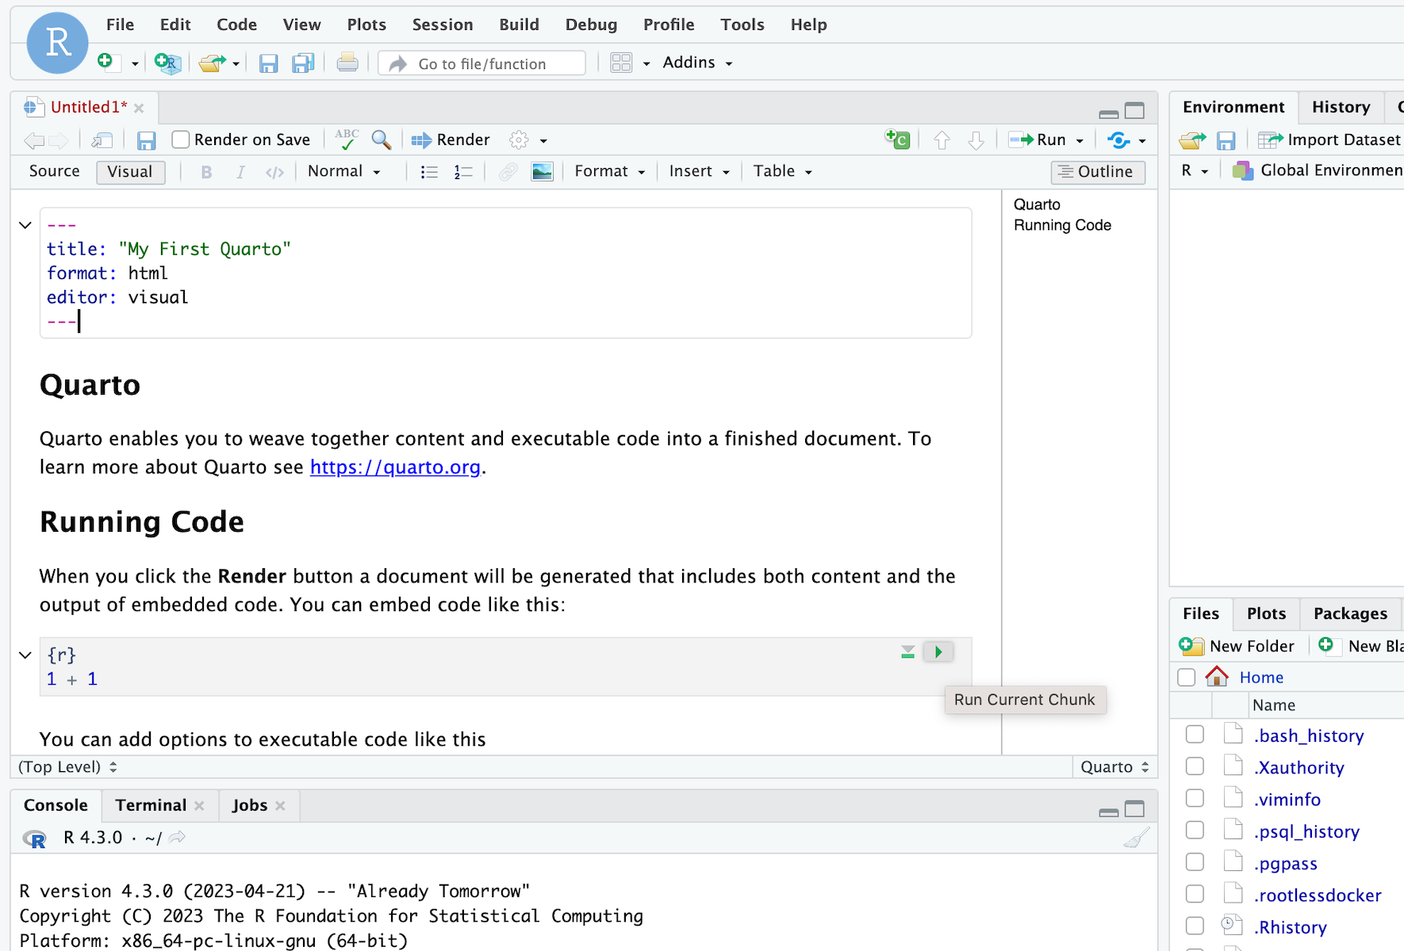
Scroll down
Hit button to run

Slide 36
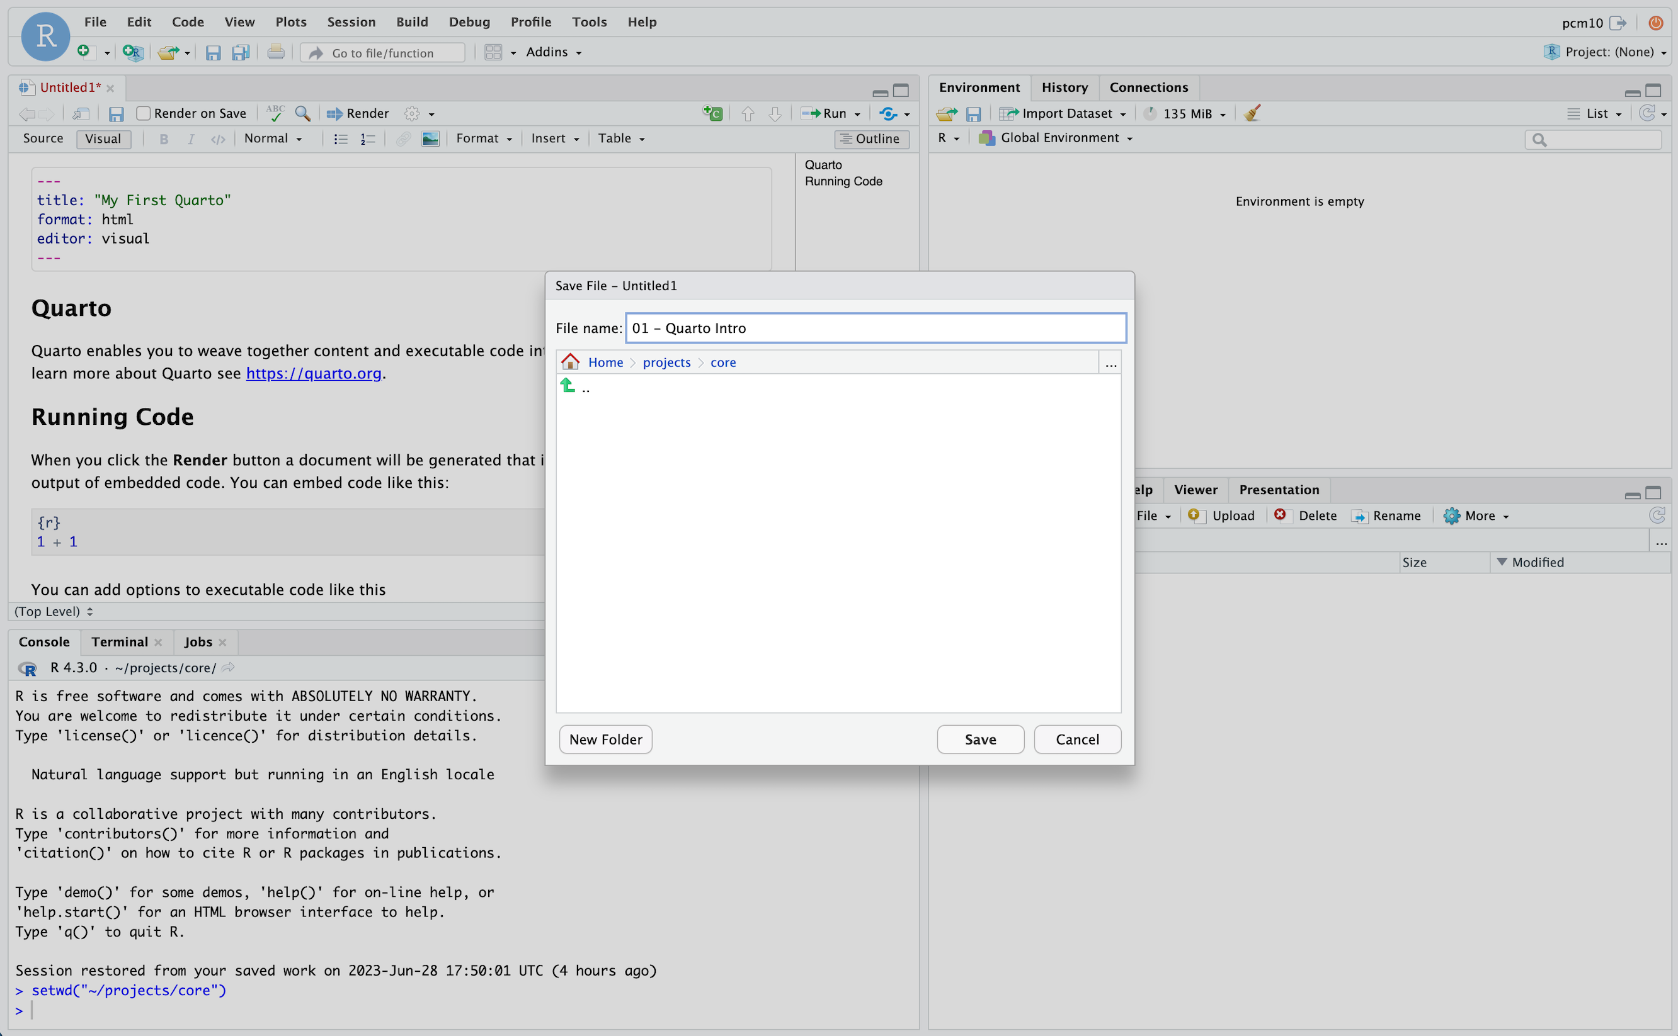
Render document
Name file
Confirm destination
Save file

Slide 37
Your Turn #2
Open a sample Quarto document (File -> New File -> Quarto Document). Enter My First Quarto as the title in the prompt and press Create.
Review the format of the document: header, text, code chunks
Execute the individual code chunks by selecting the green “play” arrow.
Render the document to HTML. You will prompted to save your Quarto Document first. Name it 01 – Quarto Intro and click save. Review the rendered document.
Notes:
It’s your turn again.
Follow the instructions in Your Turn #2 to
-open a Quarto document
-review the format
-execute individual code chunks
-render the document
We will meet back in 3 minutes to review this exercise together.

Slide 38
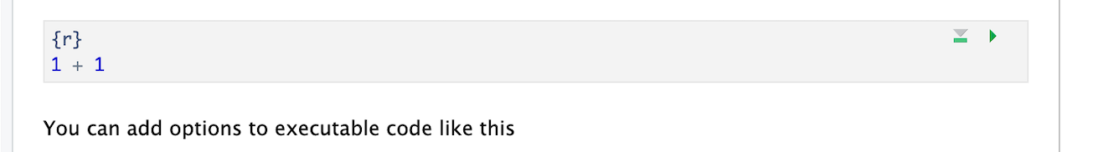
Code chunks
Language
Run chunk
Code in body of chunk
Notes:
So where does the code go?
We place these in “chunks” that are executable independently and have a very unique syntax
Backticks (top left of your keyboard) open and close code chunks

Slide 39
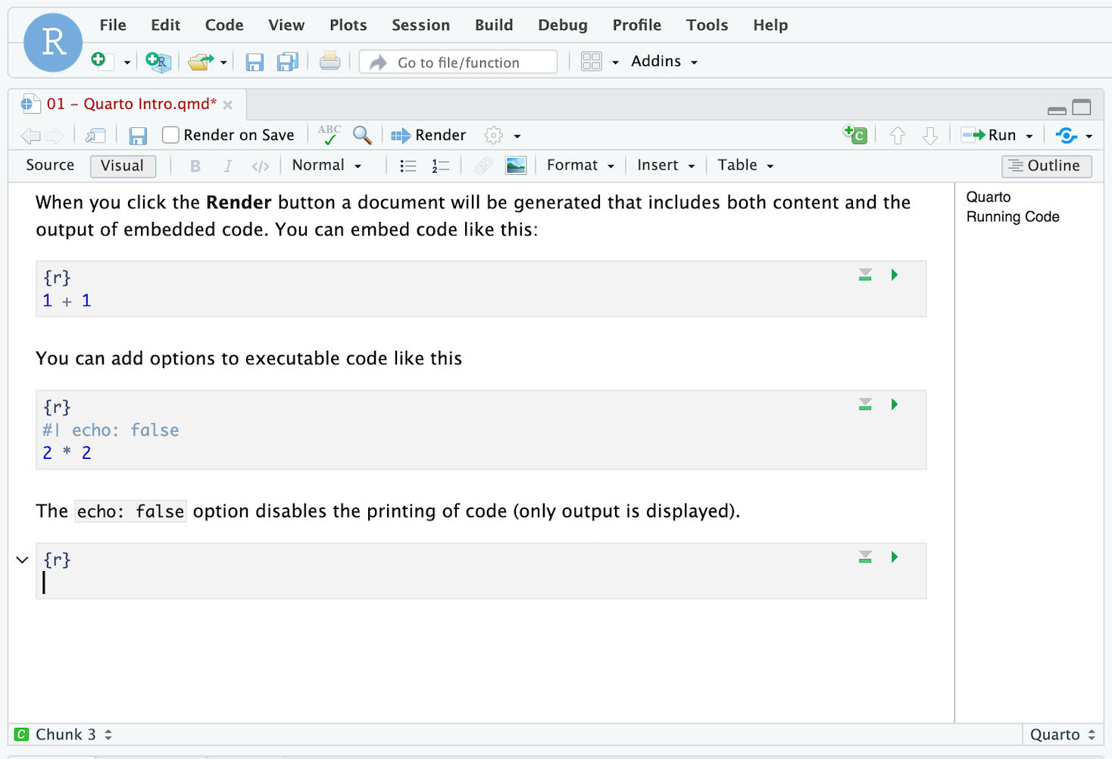
Insert code chunk
Place cursor in document

Slide 40
Your Turn #3
1. At the bottom of your document insert a code chunk into white space using the +C button on top right of the Editor window
2. Type the following into your new code chunk:
mean(c(10, 20, 30))
3. Execute code chunk by pressing the run button on top right of code chunk
4. Put up your sticky note when complete
Notes:
Annoying to type 3 backticks every time you want to insert a chunk so let’s walk through doing this with the Rstudio editor

Slide 41
Recap
Programming Language
Document Format
IDE
The RStudio Panes include editor (writing code), environment (interact with objects), misc (interact with files), and console (enter individual commands).
Reproducible Data Analysis is a best practice for working with clinical and research data.
R Markdown provides us with an electronic notebook to mix executable data analysis code elements with annotation for effective reproducibility.
Notes:
To recap what we have covered in this introductory lesson.
We started by defining and differentiating R (the programming language) from Rstudio (the development environment) from R Markdown (the document format we use for reproducible data analysis).

Slide 42
What else?
Notes:
At the end of each lesson we have included a what else section to introduce you to ”what else” you may want to explore and learn about after completing this course.
This includes helpful hints, other functions in the Tidyverse, and exciting packages you may want to check out.

Slide 43
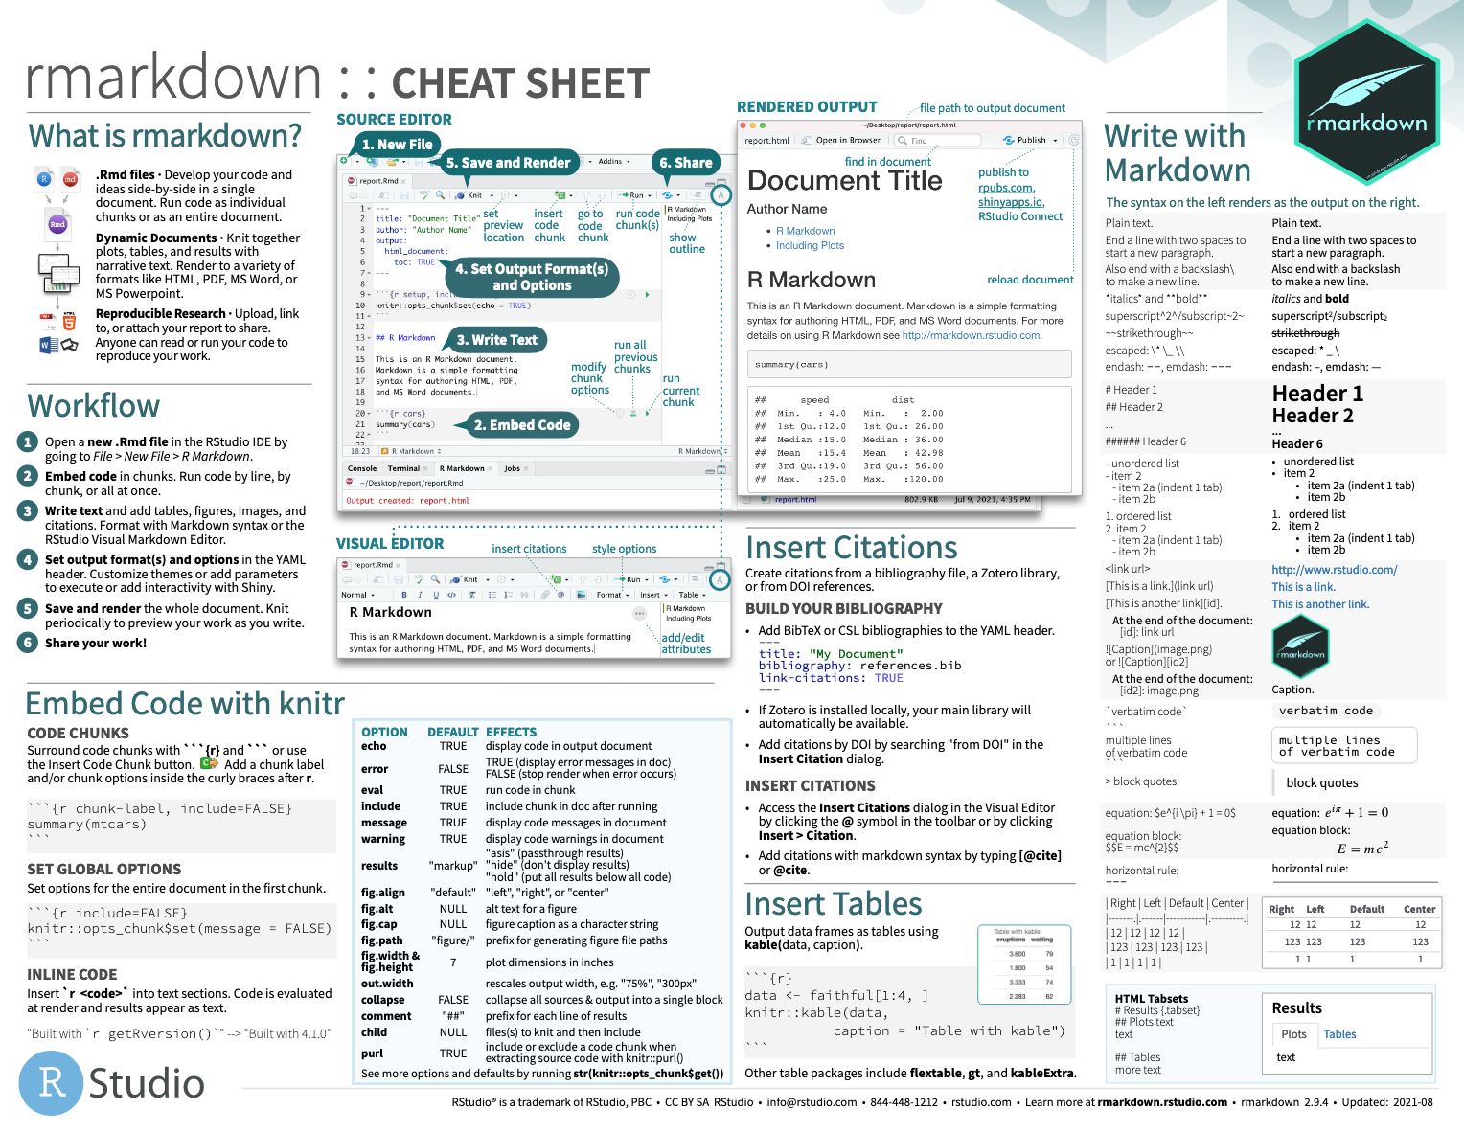
Notes:
The R Markdown cheat sheet helps with the grammar of crafting markdown documents including visual formatting options.
The R Markdown cheat sheet is available on the RStudio website.

Slide 44

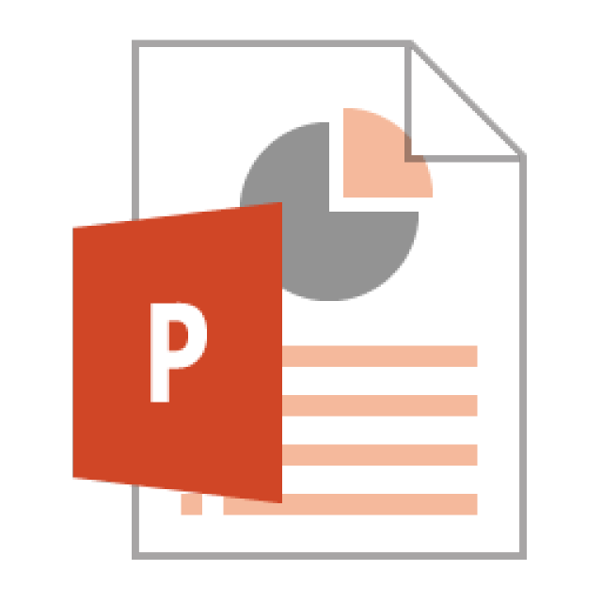



Notes:
In this lesson we practiced “rendering” our analysis to an HTML file.
In addition to HTML files, Quarto documents can be “rendered” into a number of additional formats including PDF, Microsoft Word, PowerPoint, and support for interactive dashboards is even on the horizon. We will look at dashboards in greater detail later in the course.

Slide 45
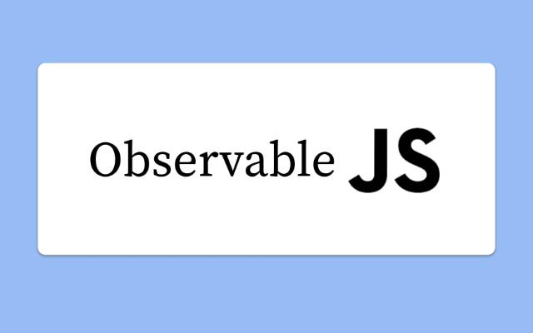


RStudio supports multiple programming languages

Slide 46
Lesson Goals
Incorporate best practices for reproducibility and transparency into data analysis projects
Utilize programming and software tools to facilitate efficient, reproducible, and transparent data analytics workflows
Lesson Objectives
Log into the DLMP RStudio server
Create folders and files through RStudio
Create and modify a Quarto document
Notes:
In this first session our goal is to develop some familiarity with the R programming language.
We will also discuss the important role of reproducible data analysis and how R can help us with this.

